Slide 1
I210 – Introduction to Programming with Python
Lecture 13

Slide 2

Today
While loops
break

Slide 3
Repetition
Sometimes, we want a loop, but we don’t know how many times we need to loop.
Example: Accept input until told to stop.
We use a type of loop known as a while loop
While loops continue until a Boolean Condition becomes False

Slide 4
While loops
while Boolean Condition:
# We do whatever's in the code block while
# the Boolean Condition is True
# We pick up here when the Boolean Condition
# becomes False

Slide 5
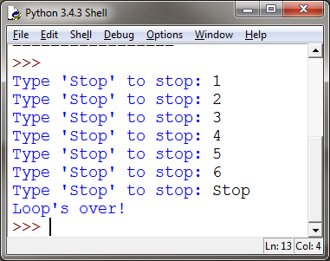
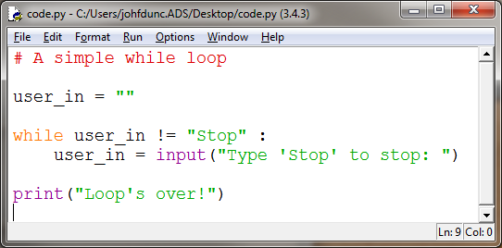
While loops

Slide 6
While loops
Sentry variable / loop control variable:
Variable used in loop condition
Infinite loop: A loop that will never end; considered a logical error
An infinite loop where the sentry variable is never updated is easy to track down.
But some forms of this error that are harder to fix…

Slide 7
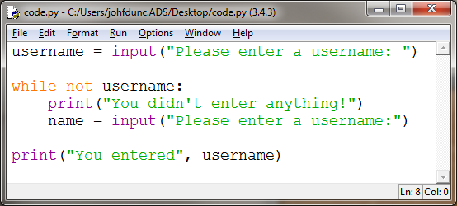
Easily Fixed Infinite Loop
>>>
Please enter a username:
You didn't enter anything!
Please enter a username: test
You didn't enter anything!
Please enter a username: test
You didn't enter anything!
etc…
name and username are not the same variable!

Slide 8

Stopping an Infinite Loop
If you get a fast infinite loop:
Don’t panic
Restart IDLE (Shell-> Restart Shell)
Or, you can hit Ctrl-F6
while True:
print("Wheeeeeeee!")

Slide 9
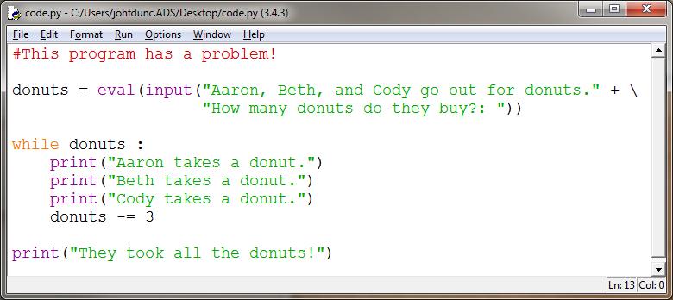
A More Challenging Infinite Loop

Slide 10

Tracing
If something’s going wrong, we may want to perform a trace on the sentry variable.
This just means using print() to output its value at each iteration in the loop.

Slide 11
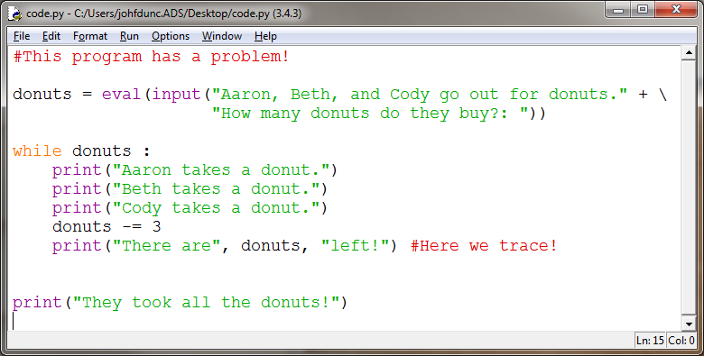
Tracing in a Loop
Question:
What happens when we run this for 12 donuts?
How about 13?

Slide 12
Creating Intentional Infinite Loops
Intentional infinite loop
Has True for its Boolean Condition
Written with an exit in the loop body
Sometimes cleaner to write than alternative loop
while True:
# Do stuff
So… how do we exit such a loop?

Slide 13
Break
We have a special instruction for loops: break.
break means we stop executing the current loop immediately, regardless of what the Boolean condition says.
“break out of it”

Slide 14
While loops with break
while Boolean Condition:
#code that might be in the loop
if Other Boolean:
break
#other code that might be in the loop
#We pick up here when Boolean Condition
# becomes false or if we break from the loop

Slide 15
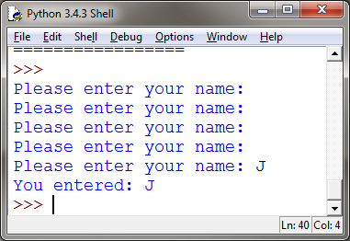
The break statement
while True:
name = input("Please enter your name: ”)
# end loop if user enters something (Remember, "" is False)
if name:
break # appears on a line by itself!
print("You entered:", name)
while True = intentionally infinite loop You must provide a break statement to leave the loop!

Slide 16

2 Basic Types of Loop
while loop:
Sentry variable (usually)
Repeat until Boolean Condition is false
Use when you don’t know how many times to loop
for loop:
Repeats over a fixed length sequence
Often, the loop control variable is a numeric counter.
Use when you know how many times to loop
VS
For and While are equivalent in power!! But usually one is more straightforward for a given problem…

Slide 17
Counting
>>>
0
1
2
3
4
5
6
7
8
9
While Loop:
count = 0
while count < 10 :
print count
count += 1
For loop:
for i in range(10):
print i
VS
In this example, while is much more work to get the same output!

Slide 18
The 4 types of Loops
while num != 4:
# don't forget to update # your loop control variable!
for i in range(len(sequence)):
# use an index number
# to accomplish something
for i in range(number):
# use when we want to do
# something number times
for piece in sequence: # do something to each element
# where we don’t care about
# the index position
Use a while loop with a Boolean Condition if you don’t know how many times you will loop.
Use a for loop with range and a numeric loop control variable if you need to know where you are in a sequence. Single letter variable.
Use a for loop with range to repeat something a fixed number of times. Single letter variable.
Use a for loop over a sequence if you just need to do something to each element, and it doesn’t require you to know where you are in the sequence.

Slide 19
The 4 types of Loops
Do we know how many times we need to repeat the loop?
No
Yes
while (Boolean Condition):
Do we need to know where we are in the sequence, or are we repeating a fixed number of times with no sequence?
No
Yes
for piece in sequence:
Repeating a fixed number of times with no sequence?
No
Yes
for i in range(len(sequence)):
for i in range(number):

Slide 20
Questions?

